Slide 1
Delightful User Experience
Android Developer Fundamentals
Lesson 5
This work is licensed under a Creative Commons Attribution-NonCommercial 4.0 International License

Slide 2
5.3 Adaptive Layouts and Resources

Slide 3
Contents
Adaptive Layout
Adaptive Resources
Alternative Resources
Default Resources

Slide 4
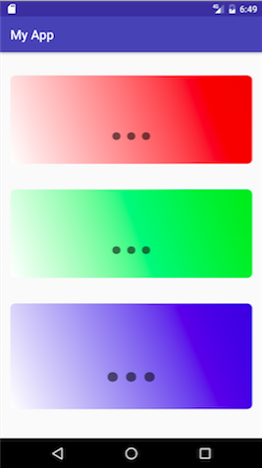
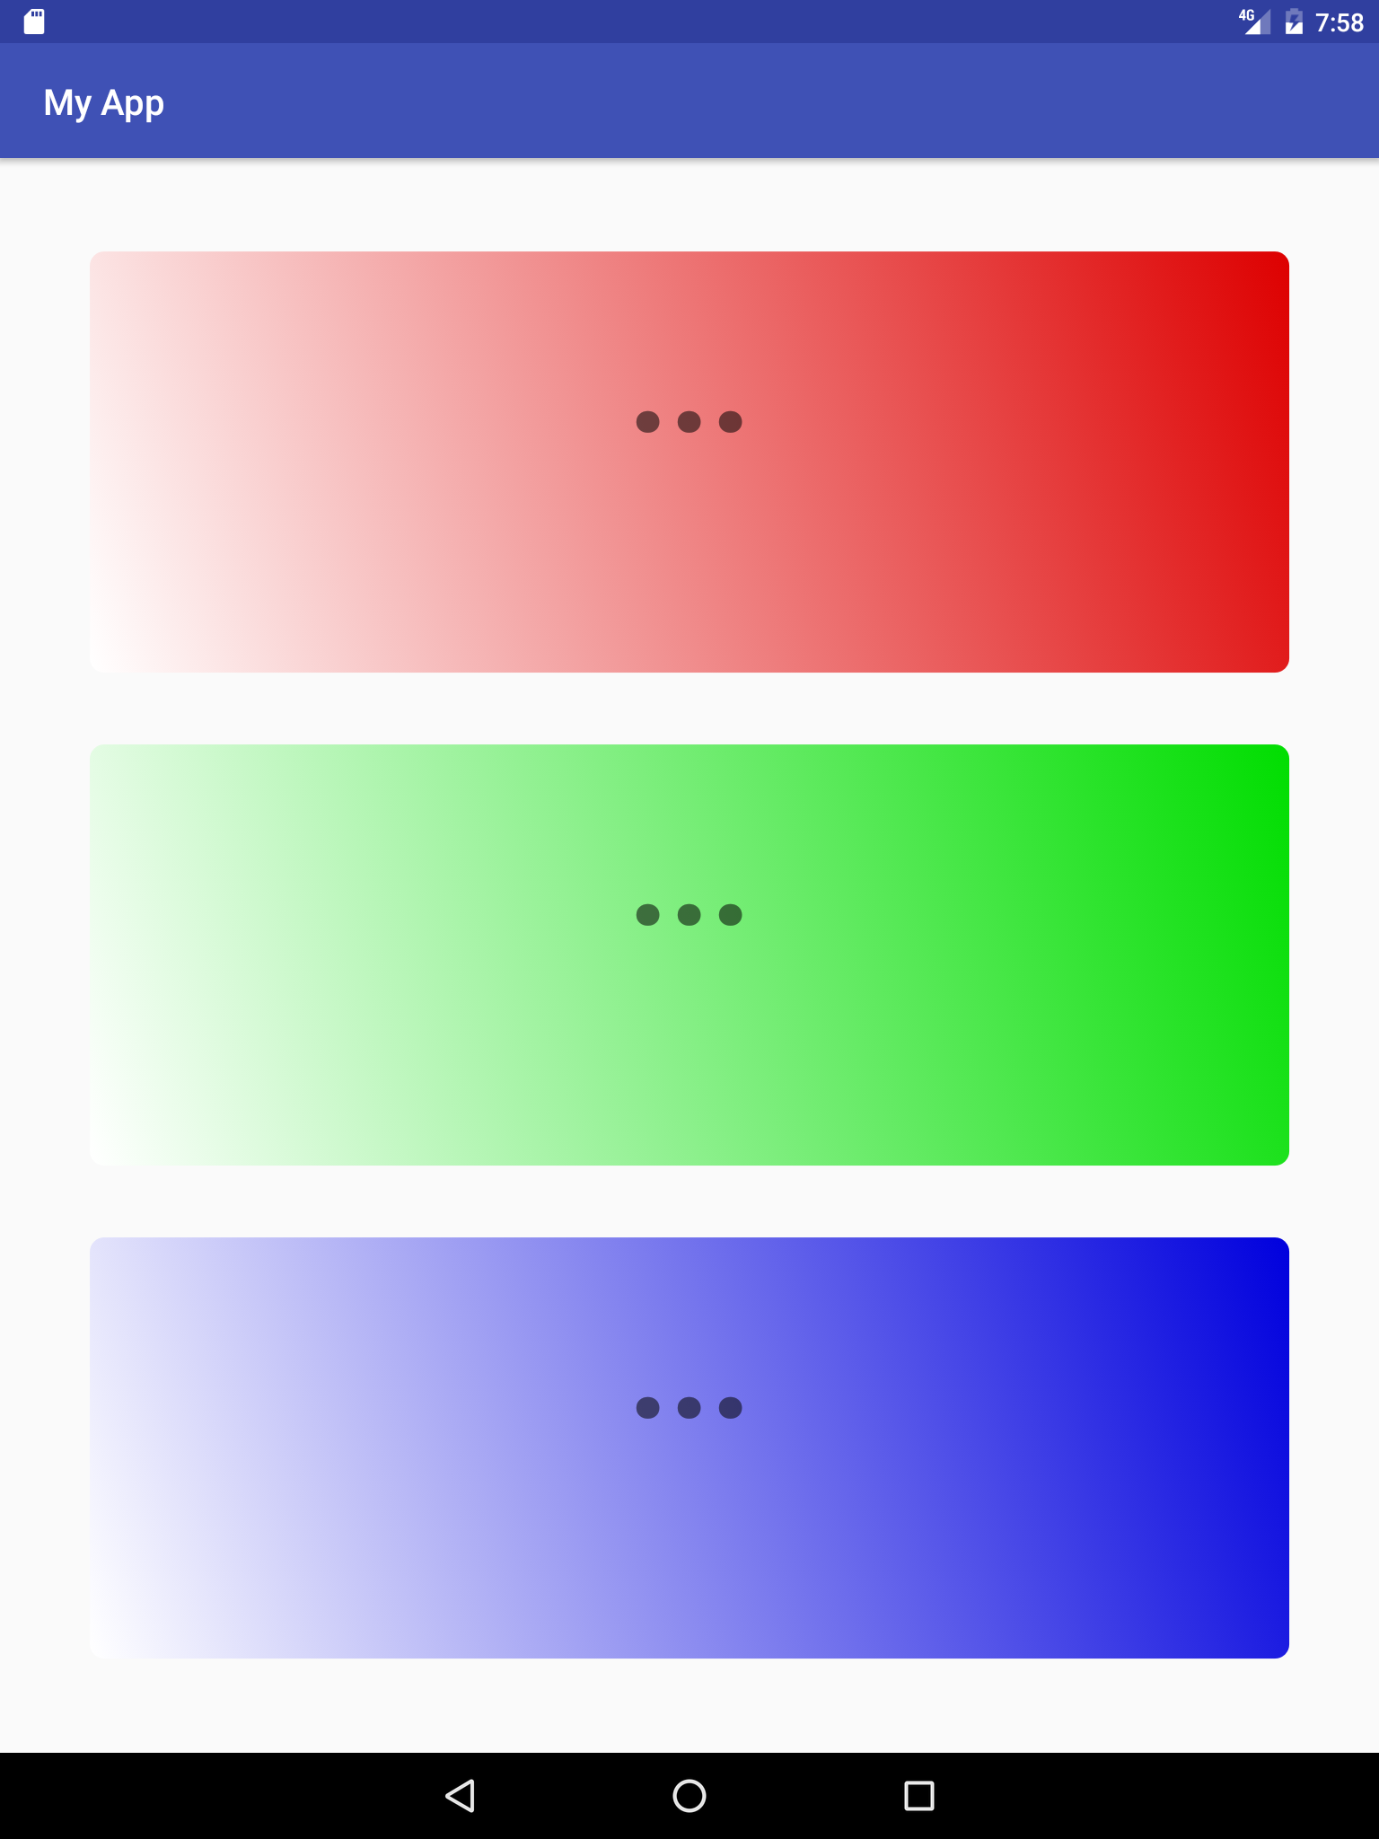
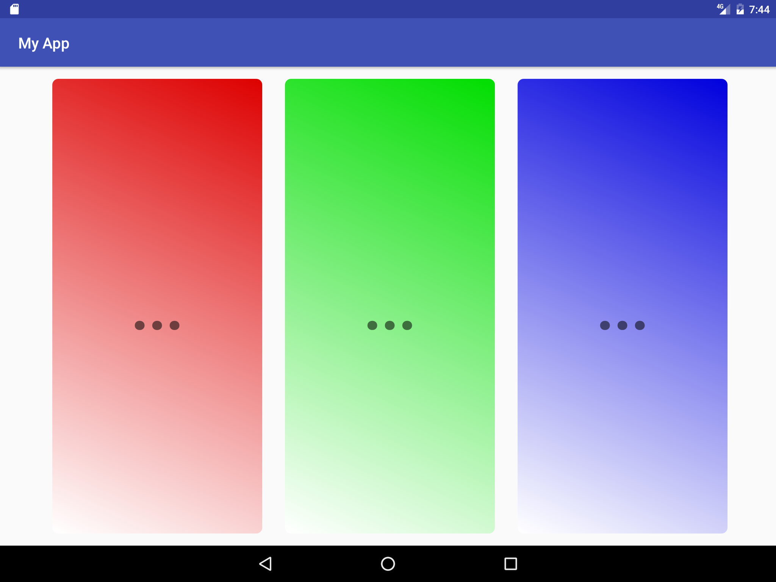
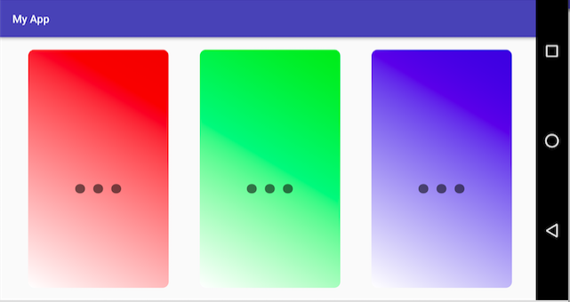
What are adaptive layouts?
Layouts that look good on different screen sizes, orientations, and devices

Slide 5
Adaptive Layouts and Resources

Slide 6
Adaptive layouts
Layout adapts to configuration
Screen size
Device orientation
Locale
Version of Android installed
Provides alternative resources
Localized strings
Uses flexible layouts
GridLayout

Slide 7
Resource folders of a small app
MyProject/ src/ res/ drawable/ graphic.png layout/ activity_main.xml list_iteminfo.xml mipmap/ ic_launcher_icon.png values/ strings.xml
Put resources in your project's res folders

Slide 8
Common resource directories
drawable/, layout/, menu/
values/—XML files of simple values, such as string or color
xml/—arbitrary XML files
raw/—arbitrary files in their raw form
mipmap/—drawables for different launcher icon densities
Complete list

Slide 9
Alternative Resources

Slide 10
What are alternative resources?
Different device configurations may require different resources
Localized strings
Image resolutions
Layout dimensions
Android loads appropriate resources automatically

Slide 11
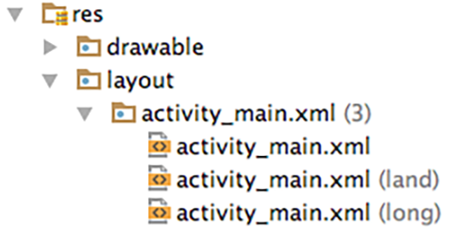
Create alternative resource folders
Use alternative folders for resources for different device configurations

Slide 12
Names for alternative resource folders
Resource folder names have the format <resources name>-<config qualifier>
drawable-hdpi | drawables for high-density displays
layout-land | layout for landscape orientation
layout-v7 | layout for version of platform
values-fr | all values files for French locale
List of directories and qualifiers and usage detail

Slide 13
Screen Orientation
Use res/layout and provide alternatives for landscape where necessary
res/layout-port for portrait-specific layouts
res/layout-land for landscape specific layouts
Avoid hard-coded dimensions to reduce need for specialized layouts

Slide 14
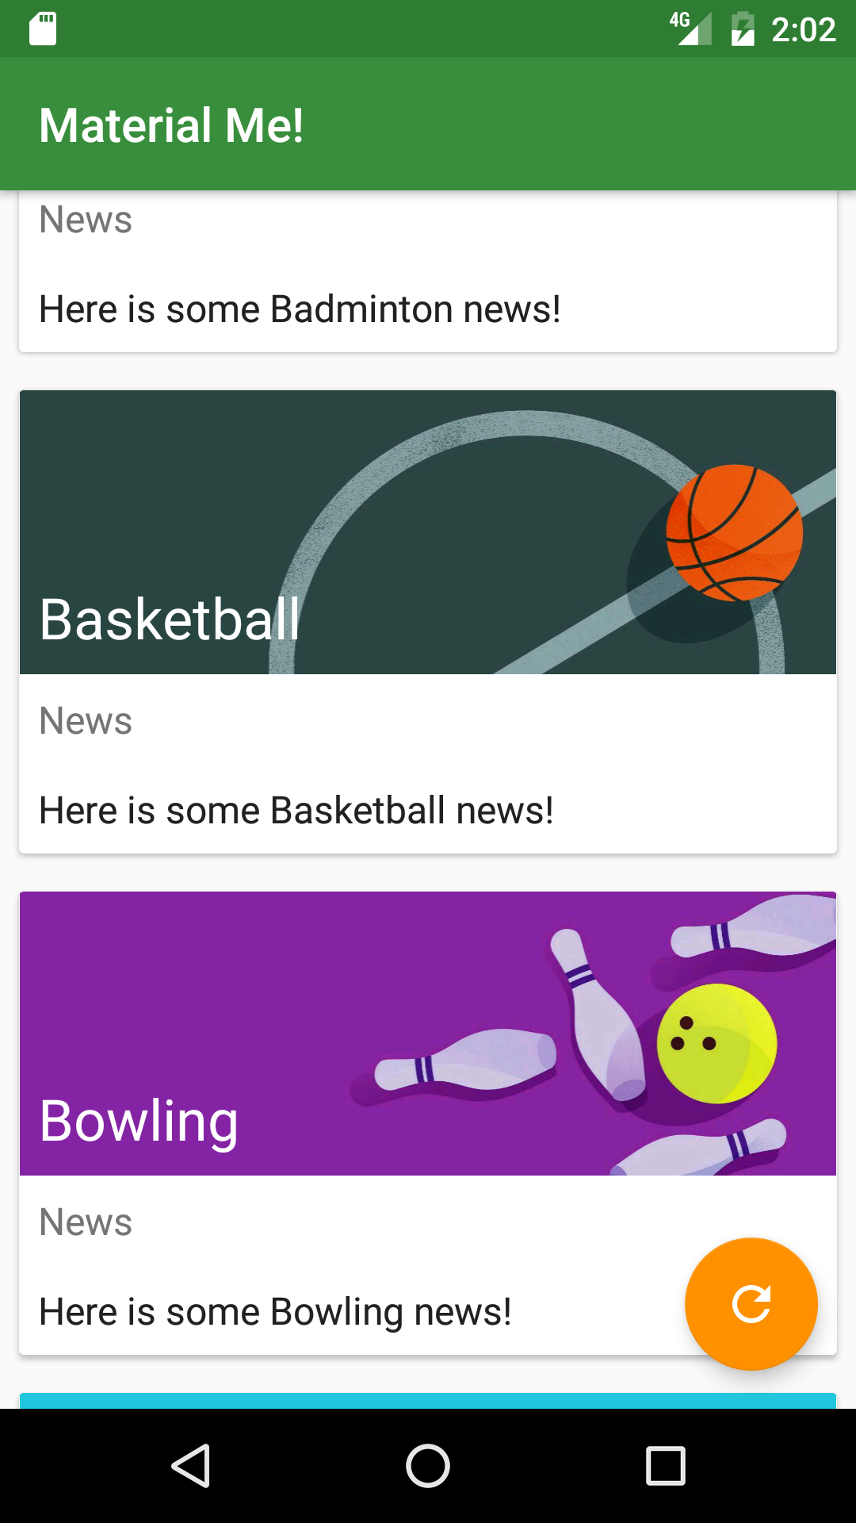
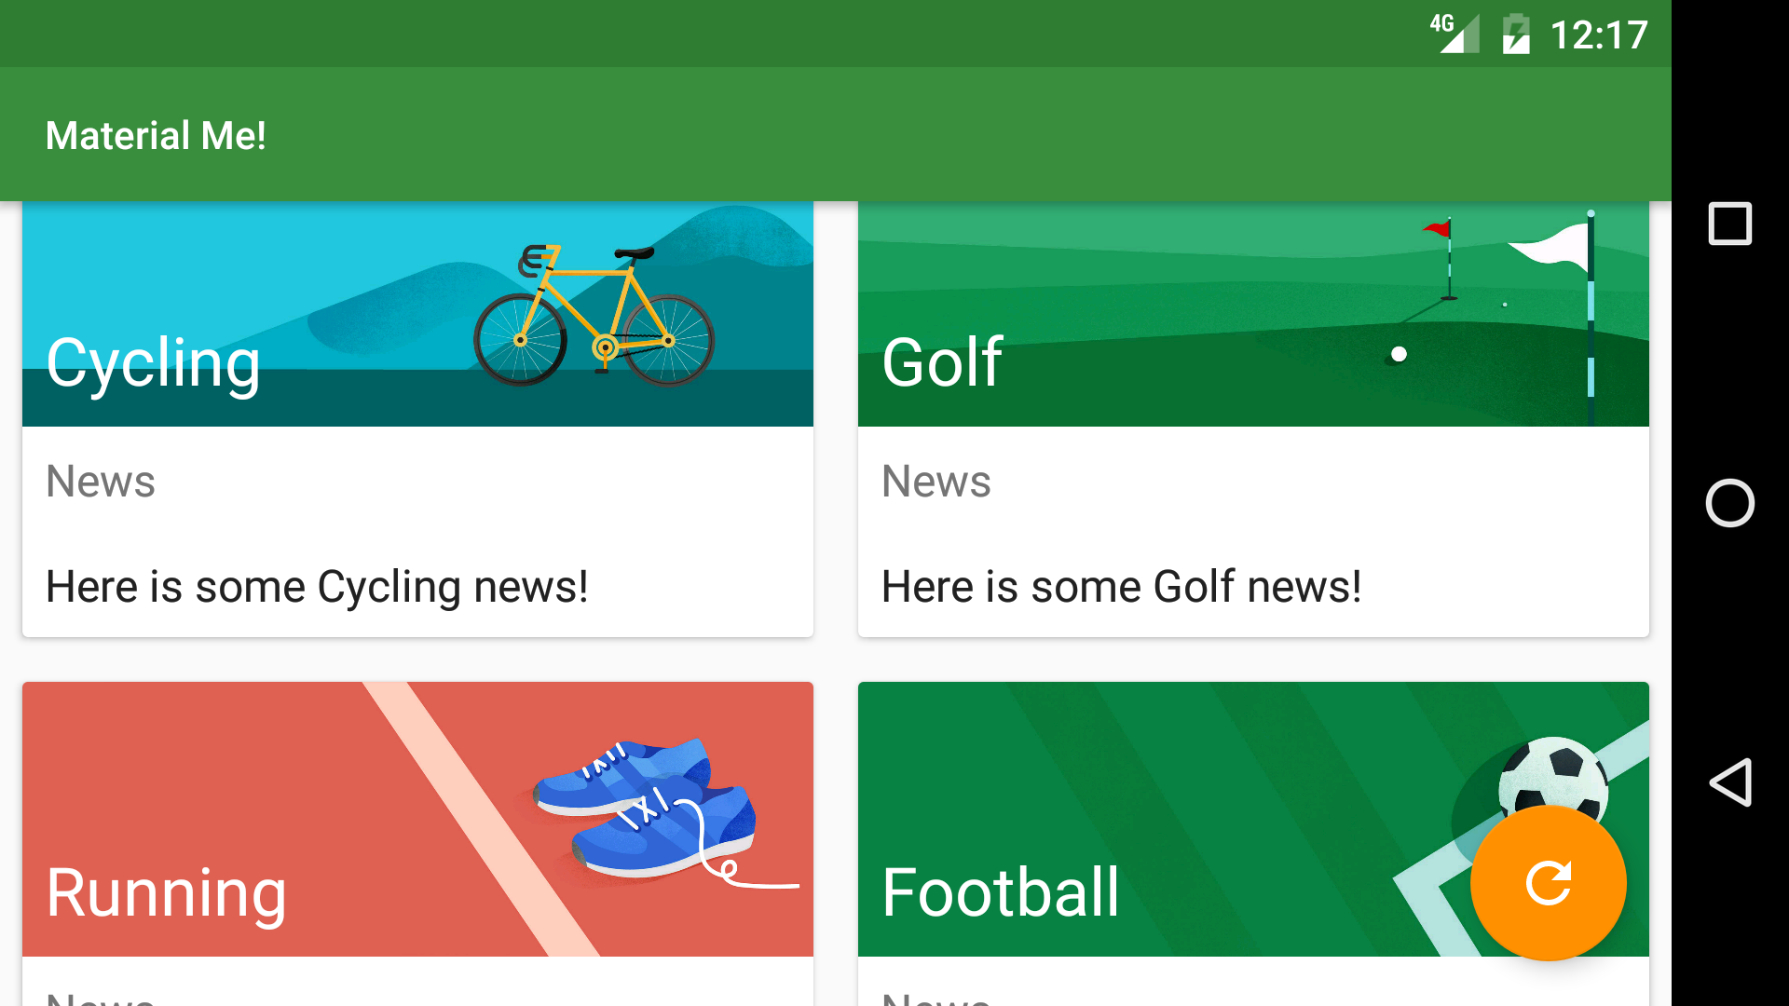
Simple adaptive layout
GridLayout
In values/integer.xml:
<integer name="grid_column_count">1</integer>
In values/integer.xml-land:
<integer name="grid_column_count">2</integer>
Landscape
Portrait

Slide 15
Smallest width
Smallest-width (sw) in folder name specifies minimum device width
res/values-sw<N>dp, where N is the smallest width
Example: res/values-sw600dp/dimens.xml
Does not change with orientation
Android uses resource closest to (without exceeding) the device's smallest width

Slide 16
Platform Version
API level supported by device
res/drawables-v14 contains drawables for devices that support API level 14 and above
Some resources are only available for newer versions
WebP image format requires API level 14 (Android 4.0)
Android API level

Slide 17
Localization
Provide strings (and other resources) for specific locales
res/values-es/strings.xml
Increases potential audience for your app
Locale is based on device's settings
Localization

Slide 18
Default Resources

Slide 19
Default Resources
Always provide default resources
directory name without a qualifier
res/layout, res/values, res/drawables….
Android falls back on default resources when no specific resources match configuration
Localizing with Resources

Slide 20
Learn more
Supporting Multiple Screens
Providing Resource
Providing Resources Guide
Resources Overview
Localization Guide

Slide 21
What's Next?
Concept Chapter: 5.3 C Providing Resource for Adaptive Layouts
Practical: 5.3 P Supporting Landscape, Multiple Screen Sizes, and Locaction

Slide 22
END

